Slide 1
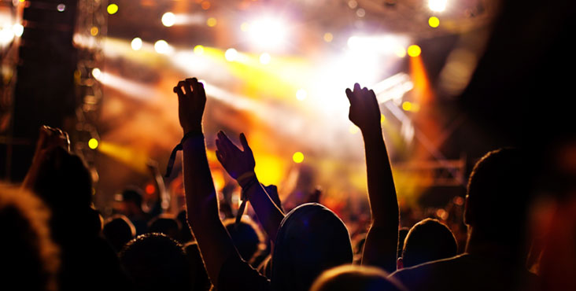

Event Recommender
Dhiviya Dhanasekar | Kushal Palesha |Prathiba Nagarajan

Slide 2
Outline
Why an event recommender?
Implementation
Challenges we faced

Slide 3

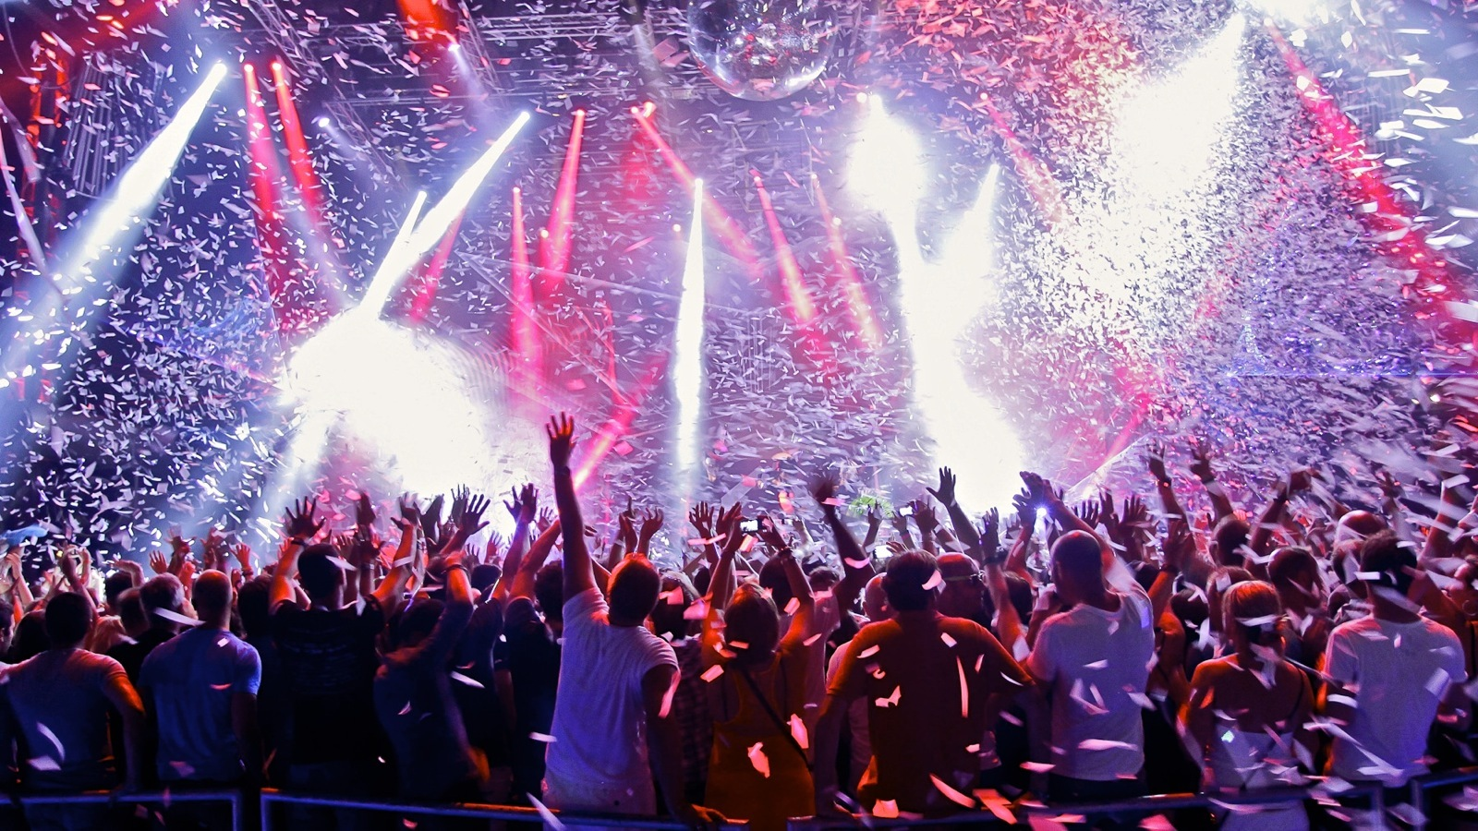

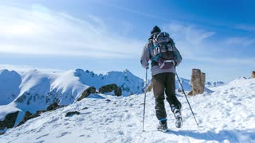

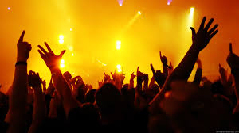
What does Homer like?

Slide 4
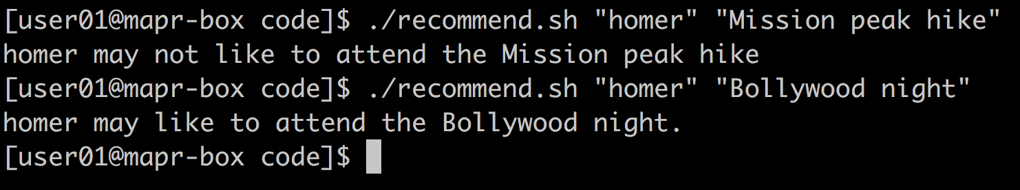
Demo

Slide 5
Why Big Data?
3M events
Notes:
TF-IDF calculation

Slide 6



How?
Use event descriptions.
Calculate TF-IDF for the 100 most frequently occurring words in the description.
TF – Term Frequency
IDF – Inverse Document Frequency
Use Cosine Similarity to gauge the similarity of the new event to Homer’s likes and dislikes.
Notes:
A lot of data. Too little time. So we decided to focus on event descriptions only. We can definitely improve the recommendation accuracy by using other features.

Slide 7
Using what?
Events
MapReduce
TF - IDF
HBase
MapReduce
Cosine Similarity
Events: Interested & Uninterested
User
Data
MapReduce

Slide 8
Challenges
Too many features/attributes
Environment to run jobs
Bulk Loading into HBase
Out of RAM – GB of data
Excessive Logging
Tuning the number of reducers

Slide 9
Summary
Event ID | ... | .. | C_1 | .. | C_100 | C_Other
2877501688 | .. | .. | 2 | .. | 6 | 72
799782433 | .. | .. | 1 | .. | 1 | 21
Event ID | C_1 | C_2 | C_3 | … | C_100
2877501688 | 0.06 | 0.0 | 0.03 | … | 0.06
799782433 | 0.0 | 0.02 | 0.01 | … | 0.0
Event 1
Event 2
Cosine Similarity
Recommendation Result

Slide 10
Appendix
Github URL:
github.com/dhiviyadhanasekar/Events_Recommender
Dataset URL:
kaggle.com/c/event-recommendation-engine-challenge/data

